Slide 1
AFTER ANAL AND RECTAL SURGERY
Dr. Hoang Ngau Tran
UMC- Proctology Department

Slide 3
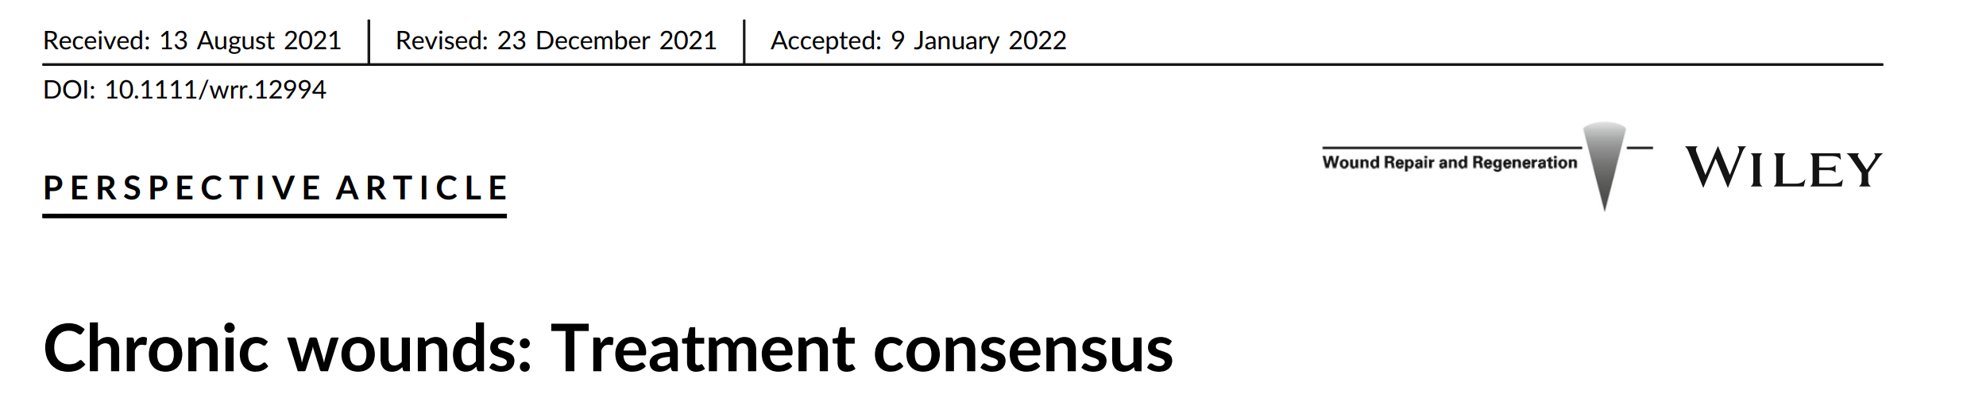
Wound
﻿Any break in the structural and functional integrity of the skin
﻿A wound with failure → 4 weeks→ chronic
﻿The wound surface area is reduced by 50% → the same treatment in 12 weeks.
If less than a 50% reduction occurs →reassessment and change of treatment
Notes:
﻿﻿6. Snyder D, Sullivan N, Margolis D, et al. Skin Substitutes for Treating
Chronic Wounds [Internet]. Agency for Healthcare Research and 168 ERIKSSON ET AL.Quality (US); 2020. https://www.ncbi.nlm.nih.gov/books/ NBK554220/

Slide 4
Wound
WOUND HEALING
Wound factors
Patient factors
Education factors

Slide 5
Wound factors
Wound depth/ size
Wound chronicity
Tissue perfusion ( local blood supply)
Necrotic tissue
High bacterial load ( infection)
Oedema
Excess exudate
Skin damage and barrier function
WOUND HEALING
Wound factors
Patient factors
Education factors
Notes:
﻿6. Snyder D, Sullivan N, Margolis D, et al. Skin Substitutes for Treating Chronic Wounds [Internet]. Agency for Healthcare Research and 168 ERIKSSON ET AL.Quality (US); 2020. https://www.ncbi.nlm.nih.gov/books/ NBK554220/
﻿9. Sheehan P, Jones P, Caselli A, Giurini JM, Veves A. Percent change in wound area of diabetic foot ulcers over a 4-week period is a robust predictor of complete healing in a 12-week prospective trial. Diabetes Care. 2003;26(6):1879-1882.
10. Kantor J, Margolis DJ. A multicentre study of percentage change in venous leg ulcer area as a prognostic index of healing at 24 weeks. Br J Dermatol. 2000;142(5):960-964

Slide 6
Patient factors
Co- morbidities
Immune status
Effects of pain
Altered mood
Depression
Reduced motivation
Social isolation
Lack of education/ support
Poor compliance
Inability to self care
WOUND HEALING
Wound factors
Patient factors
Education factors
Notes:
﻿Systemic\ illness most relevant to wound healing is diabetes mellitus
﻿Malnutrition is another systemic setting for impaired wound healing, and occurs when the body is deprived of vitamins, minerals
and other nutrients it needs to maintain healthy tissue and organ functions.13 It occurs in both undernourished and over-nourished individuals. Normal collagen synthesis, required for new extracellular
matrix formation, as an example, requires adequate protein intake,
cofactors such as Vitamins A and C, and zinc.14 We diagnose protein
Giảm động lực
Cách ly xã hội
Thiếu giáo dục / hỗ trợ
Tuân thủ kém
Không có khả năng tự chăm sóc
synthetic function in a patient by measuring serum albumin, retinolbinding protein, prealbumin, transferrin, creatinine and blood urea nitrogen.
﻿Connective tissue diseases include diagnoses such as rheumatoid
arthritis, scleroderma, lupus, polyangiitis and more

Slide 7
Educational factors
Traditional knowledge
Ritualistic practice
Lack of understanding
Negative attitudes
Information overload
Poor quality research
Lack of critiacal apparaisal skills
Inappropriate training and support
WOUND HEALING
Wound factors
Patient factors
Education factors

Slide 8
The outcome of wound assessment
Improve clinical decision making
Make clinical outcomes more achievable
Improve cost effectiveness
Indentify the patient’ s expectations
Facilitate better communication
Notes:
Cải thiện việc ra quyết định lâm sàng
Làm cho các kết quả lâm sàng dễ đạt được hơn
Cải thiện hiệu quả chi phí
Xác định những mong đợi của bệnh nhân
Tạo điều kiện giao tiếp tốt hơn

Slide 9
Listening – Establishing a clear history
Finding out the patient’s main concerns
Helps to indentify factors that may delay healing
Establishing a rapport with patient and familly

Slide 10
Listening- History of presenting complaint
Key skill
Listen carefully
Use questions appropriately
Start with open questions
Encourage the patient to talk
Keep the patient focused on the problem
Use closed questions to clarify or probe
Summarise the understanding of what has been said

Slide 11
Question to ask
How is your general health?
What medications do you take?
How long have you had your wound?
What makes your wound better / worse?
Is your wound painful? If so describe the pain?
How does your wound affect you every day?
What previous wound treatment have you had?

Slide 12
Looking
Observation of dressing
Dry
Moist
Wet
Saturated
Leaking
Notes:
Excoriation: lot da
Maceration: mem nhun
Callus: chai
Undermining; hoai tu

Slide 13
Smell
Smell can reveal several things:
Poor personal hygiene
Incontinence faeces
Wound exudate
Wound infection
Necrosis and slough
Malignancy

Slide 14
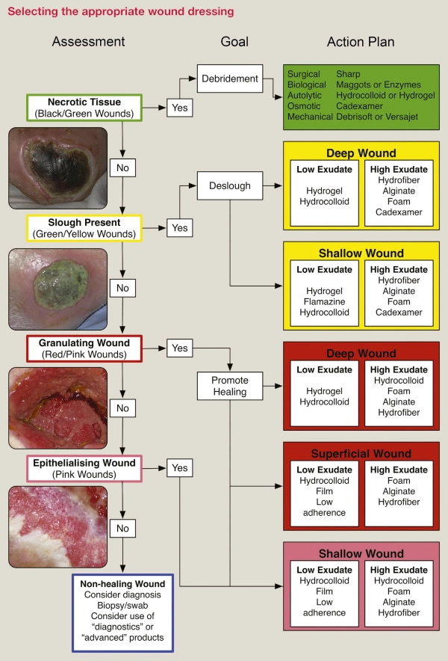
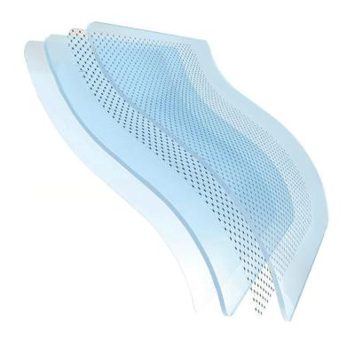
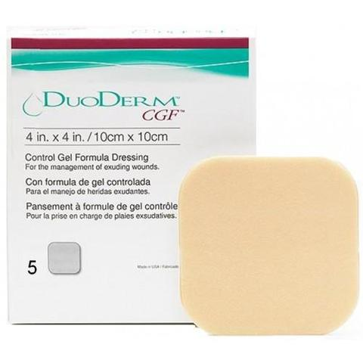
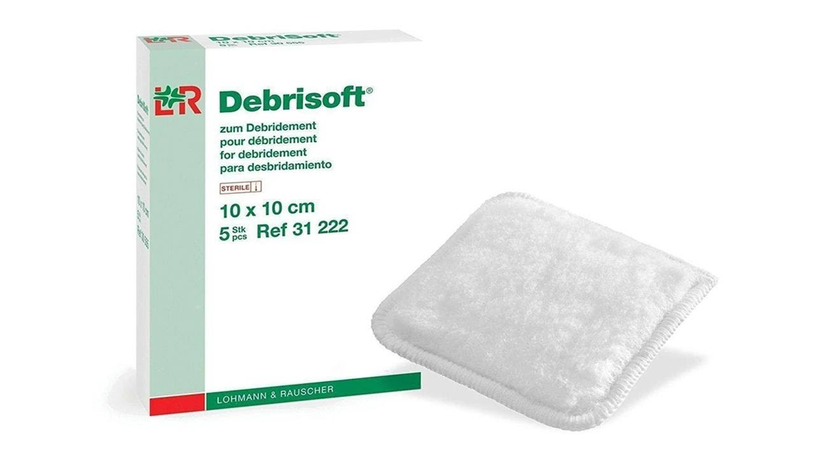
Hydrogel
Hydrocolloid
Debrisoft
Notes:
Osmotic: tham thau
Deslough: boc gia mac
Hydrogel là một loại polymer siêu hấp thụ
Cadexamer thuong ket hop iod haaps thu nuowc
Debrisoft: mieng lau VT
Hydrocolloid dressings are described as wafers, powders, or pastes composed of materials such as gelatin, pectin, and carboxymethyl-cellulose.
Versajet:hydrosurgery system
Gạc Alginate được dùng để che phủ / lấp đầy cho nhiều vùng vết thương, với cả những vùng có nhiều vi khuẩn trú ngụ. Cấu tạo chính từ các sợi canxi – natri có xuất xứ từ rong biển có thể thấm hút lượng dịch từ vừa phải cho đến lớn đồng thời có thể kiểm soát tình trạng ch

Slide 15
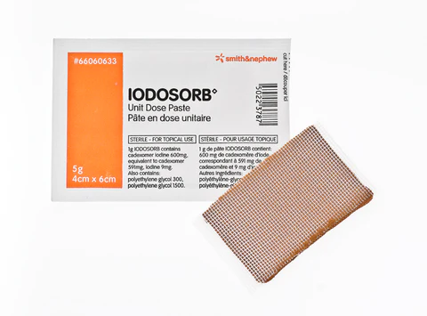
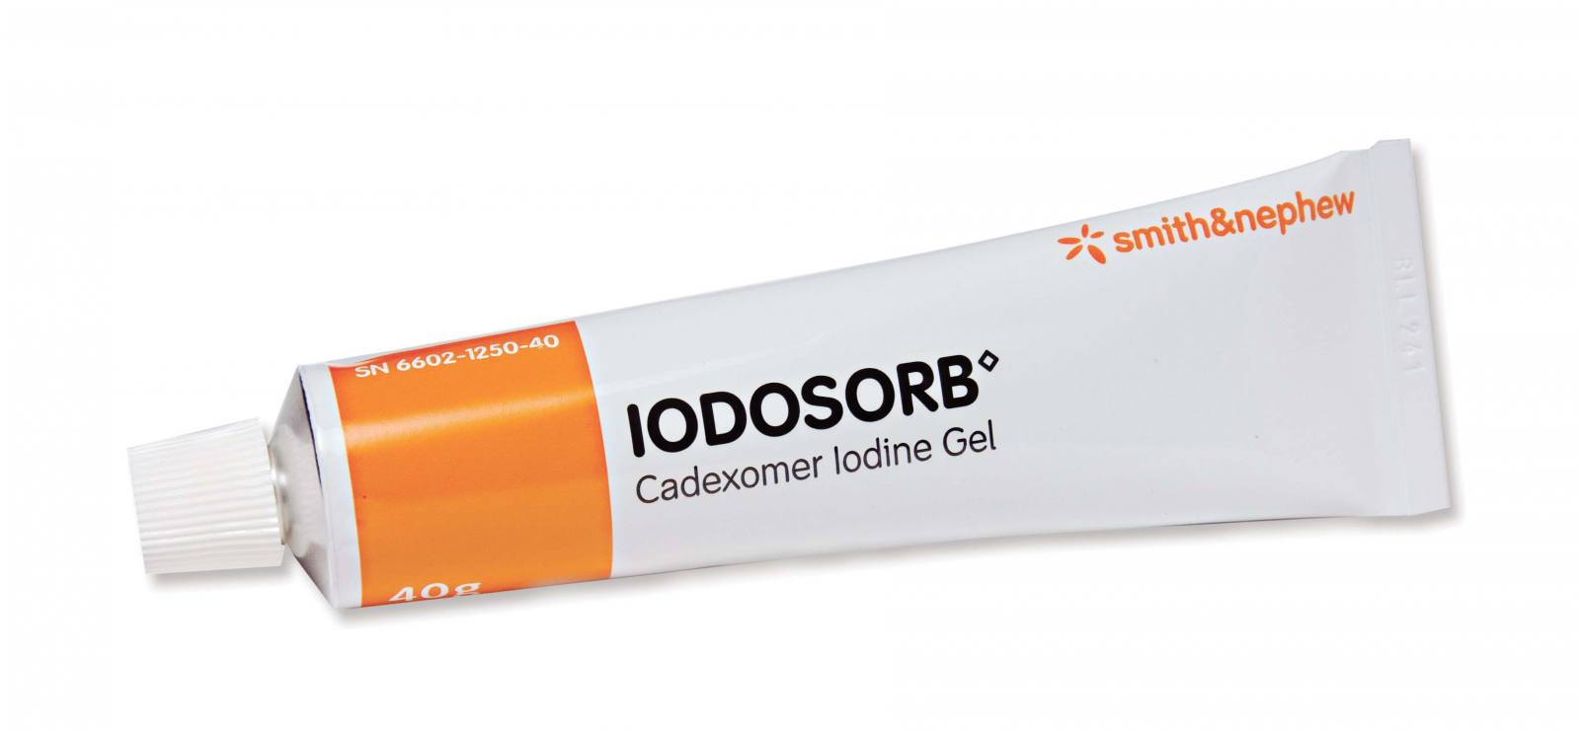
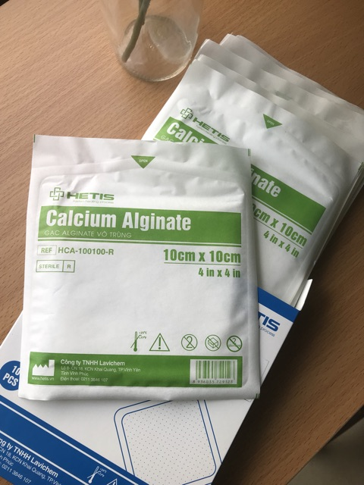
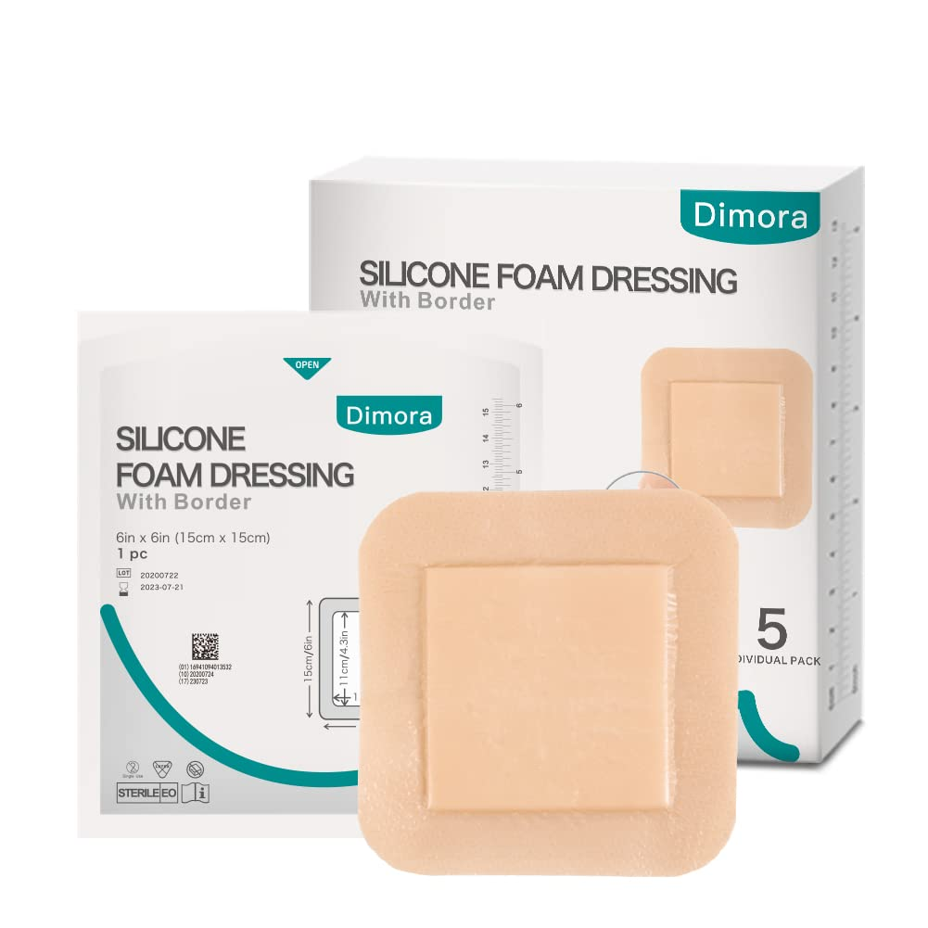
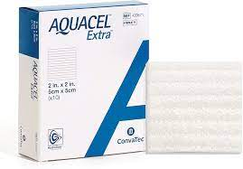
Cadexomer
Hydrofiber

Slide 16
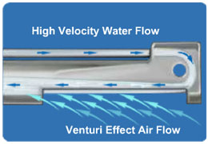
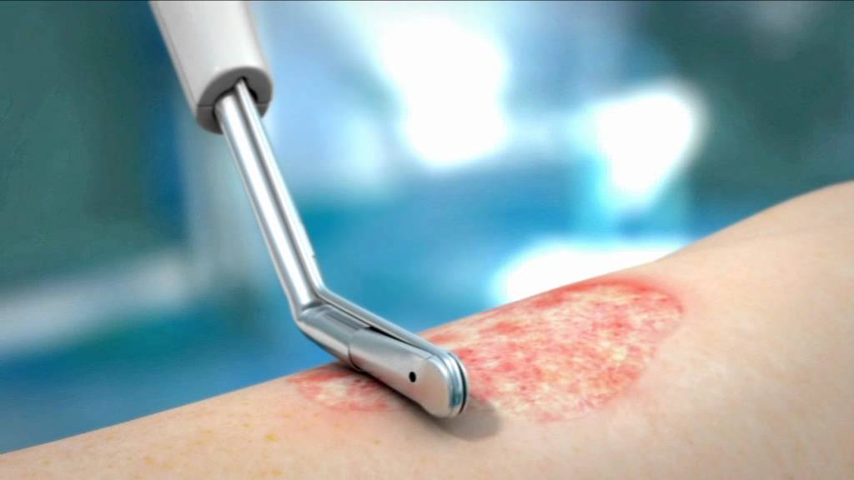
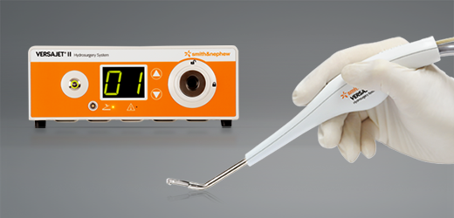


Slide 17
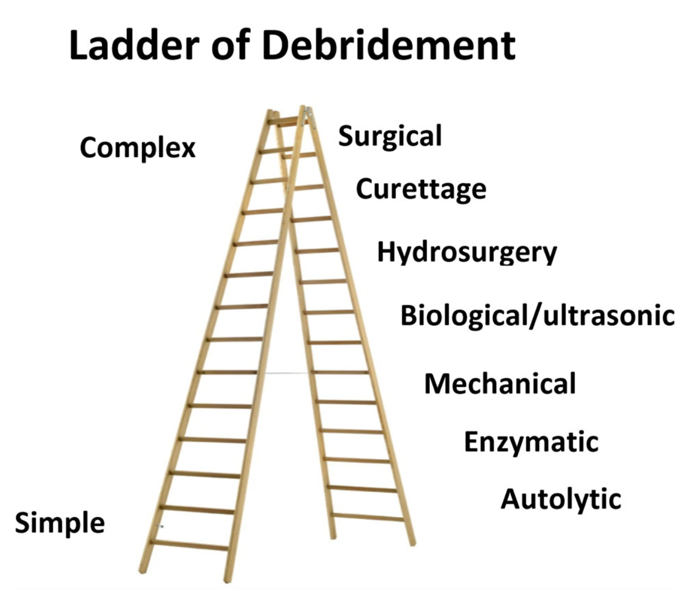
﻿DEBRIDEMENT
﻿Debridement is the removal of non-viable wound components
Necrotic material
Slough
Biofilm
﻿Ladder of complexity of debridement. The bottom rungs are the least complex methods and require the fewest resources
Notes:
﻿The ladder of debridement roughly parallels cost and efficacy as well, with wound beds being demonstrably cleaner and more vascular after surgical debridement. This will enhance surgical outcomes.28 But this may require in-patient hospitalisation and general anaesthesia and may be more expensive than outpatient visits.

Slide 18
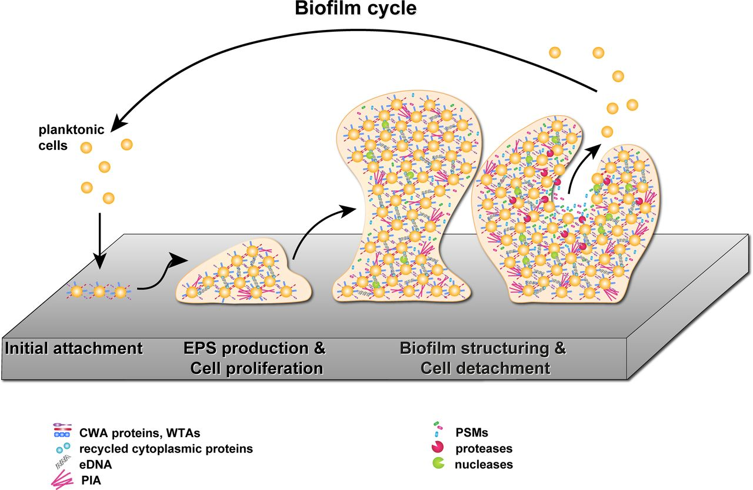

Slide 19
﻿DEBRIDEMENT
﻿Surgical debridement:
Anaesthesia
Done with scalpel, curettage or tangential ﻿hydrosurgery
Notes:
﻿Initial assessment for ischemia is critical prior to debridement since in ischemic wounds, surgical debridement may cause
extension of the necrosis.32,33 Bleeding requiring electrocautery may
create a thermal injury which can extend the tissue injury.28 The
majority of chronic wounds likely will benefit from serial surgical
debriding to facilitate either secondary closure or healing with grafting
or tissue transfer.28

Slide 20
﻿DEBRIDEMENT
early as possible
﻿Hydrosurgery
Tissue is friable
Tangential excision is required as in burns
Large wounds with a thin layer of non-viable tissue

Slide 21
﻿DEBRIDEMENT
Mechanical debridement:
Hydro-jet
Ultrasound
Pulsatile lavage
Gauze abrasion
Wet-to-dry dressings.
Without local anaesthesia

Slide 22
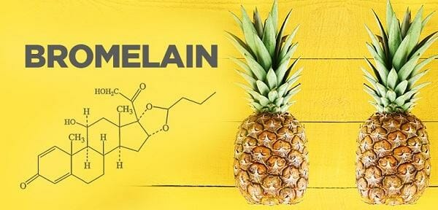
﻿DEBRIDEMENT
Enzymatic debridement degrade components of necrotic tissue :
Chemicals
Enzymes
→ Bromelain and collagenase
Additional surgical preparation if grafting

Slide 23

﻿INFECTION CONTROL
﻿Systemic antibiotics (parenteral or oral): 10 days
Clinically invasive infection
Haemolytic streptococci
Osteomyelitis (>= 6 weeks)
Notes:
Kháng sinh toàn thân (đường tiêm hoặc đường uống): 10 ngày
Nhiễm trùng xâm lấn lâm sàng
Liên cầu khuẩn tan huyết
Viêm tủy xương (> = 6 tuần)

Slide 24
﻿INFECTION CONTROL
﻿Topical antibiotics: low cytotoxicity in high concentration
Minocycline and gentamycin → cleared by (FDA). Both can be delivered in concentrations of up to 100 MIC
Minocycline: Gram+ bacteria and in high concentrations against many Gram bacteria including Pseudomonas.
Notes:
the United States Food and Drug Administration
minimum inhibitory concentration (MIC).
Minocycline được sử dụng để điều trị nhiều loại bệnh nhiễm trùng khác nhau, bao gồm mụn trứng cá. Thuốc này thuộc nhóm thuốc kháng sinh tetracycline,
Gentamicin là một kháng sinh thuộc nhóm aminoglycoside

Slide 25
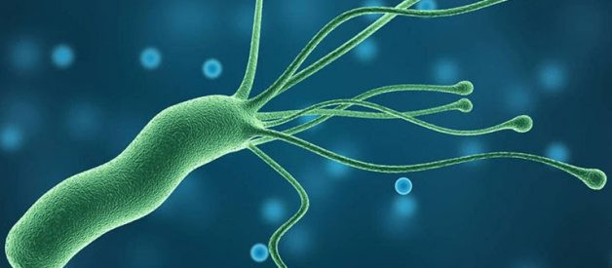
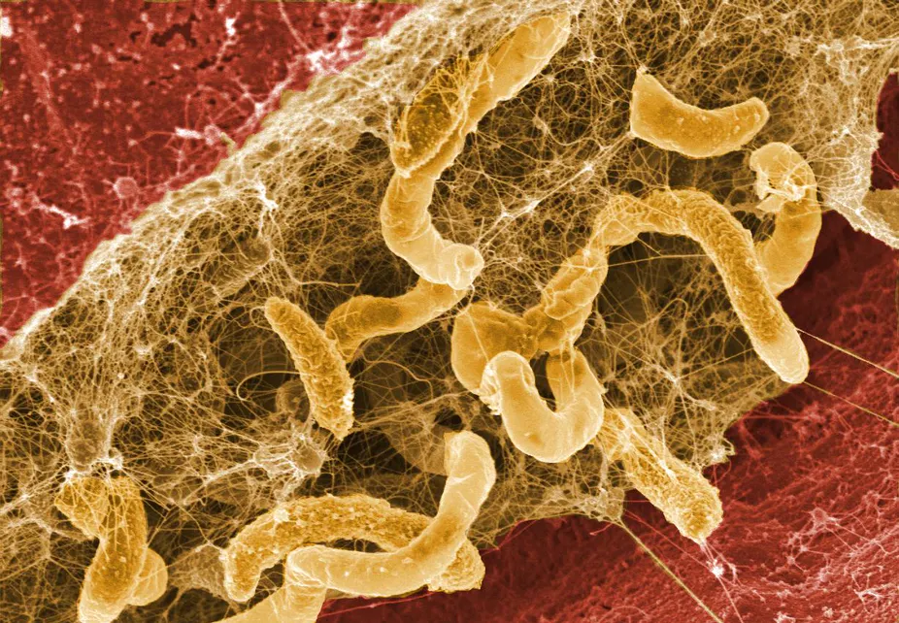
﻿INFECTION CONTROL
After debridement the wound is treated with an antimicrobial such as hypochlorous acid, cadexomer iodine, Ag+ and others.
Washing and scrubbing the wound
Notes:
treating agents and the biofilm regrows.

Slide 26
﻿DRESSING MANAGEMENT
The main functions:
Protection
Exudate/moisture management
Pain reduction
Aesthetics
Compression
Offloading
Immobilisation
Negative pressure wound therapy (NPWT).
Notes:
Các chức năng chính:
Sự bảo vệ
quản lý dịch tiết / độ ẩm
giảm đau
tính thẩm mỹ
Nén
Giảm tải
Cố định
Trị liệu vết thương bằng áp lực âm (NPWT).

Slide 27
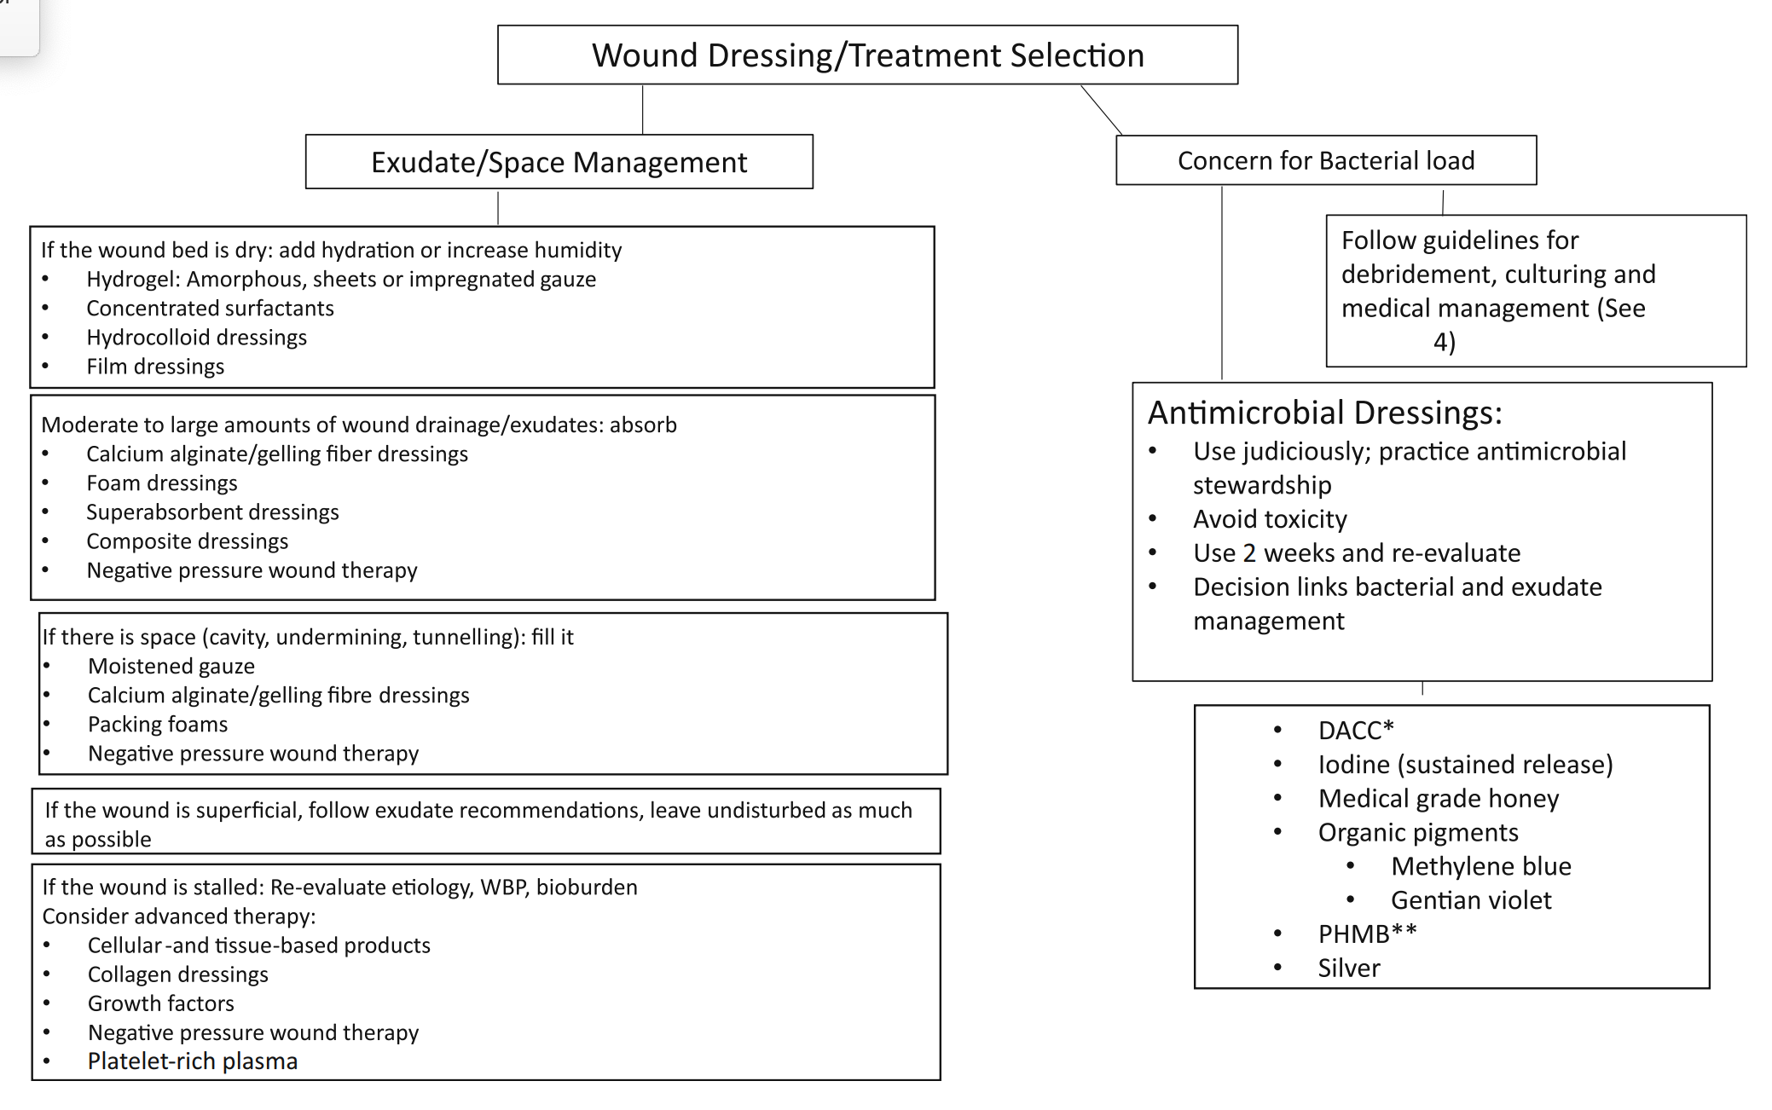
﻿DRESSING MANAGEMENT
Notes:
﻿polyhexamethylene biguanide: protosan
﻿Schematic representation of decision-making for dressing selection.
DACC, dialkylcarbamoyl chloride;
PHMB, polyhexamethylene biguanide

Slide 28
﻿GRAFTING
﻿Autologous skin grafts
﻿1. Split-thickness skin grafts
2. Full-thickness grafts
3. Epidermal skin grafts
4. Composite grafts
Autologous fat grafts
﻿Non-autologous grafts
﻿Future technologies

Slide 29
﻿PAIN MANAGEMENT
﻿Wound pain:
Presence of the wound
The disease process (neuropathy, inflammation, ischemia and infection)
Treatment procedures (including debridement, dressing changes and cleansing)
A very low pain tolerance

Slide 30
﻿PAIN MANAGEMENT
→ effects of pain on their quality of life.
Does it interfere with sleep?
Does it influence appetite, activities of daily living?
Does it prevent work, family, and social life?
Does it limit mobility or exercise?
Findings should be documented in the medical record.

Slide 31
﻿PAIN MANAGEMENT
WHO → three-step for cancer patients, and conceptually this can be applied to wound care.
Step 1: A non-opioid analgesic (NSAID). Adjuvants include tricyclic antidepressants anticonvulsants, antihistamines, benzodiazepines, steroids and phenothiazines.
Step 2: If pain is not controlled: + an opioid, such as codeine or tramadol, and an adjuvant.
Step 3: When a patient does not respond→ discontinued and a more potent oral narcotic initiated

Slide 32
﻿HYPERBARIC OXYGEN
﻿Increase oxygen delivery to the wound with potentially beneficial effects
﻿Local wound vasodilation
Increased neutrophil bactericidal activity
An overall modulation of wound inflammation
Notes:
﻿The concept of using enriched oxygen
in a pressurised environment is relatively ancient from a medical perspective, having been initially described in the late 17th century.83,84
However, the widespread usage of HBOT did not occur until the mid-
20th century when it was popularised for a variety of medical conditions including cardiac surgery, necrotizing infections and chronic
wounds.

Slide 33
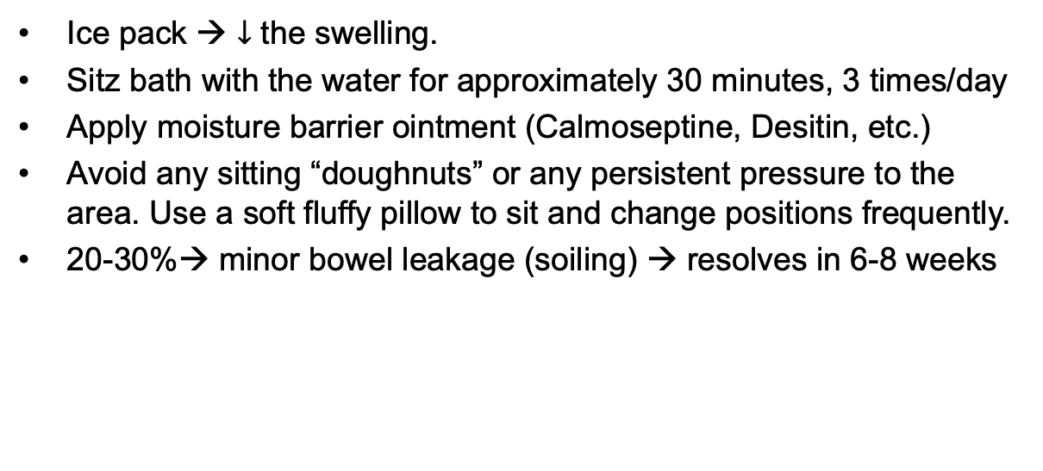
ANAL WOUND CARE
Ice pack → $↓$ the swelling.
Sitz bath with the water for approximately 30 minutes, 3 times/day
Apply moisture barrier ointment (Calmoseptine, Desitin, etc.)
Avoid any sitting “doughnuts” or any persistent pressure to the area. Use a soft fluffy pillow to sit and change positions frequently.
20-30%→ minor bowel leakage (soiling) → resolves in 6-8 weeks

Slide 34
ANAL WOUND CARE
ACTIVITIES:
Out of bed, use the stairs.
No heavy lifting or strenuous exercise for 2 weeks.
Drive when you are no longer taking narcotics for pain.
Return to work or full activity without significant pain. It may be 3 to 7 days (i.e. fissure surgery) or 3 to 6 weeks (i.e. standard hemorrhoidectomy, complex fistulotomy or sphincteroplasty).

Slide 35
ANAL WOUND CARE
Constipation
A bowel movement at least every other day.
If two days pass without one→ ounce of milk of magnesia;
If there is no result, repeat this dose in six hours→ phosphate enema or tap water enema.
Diarrhea
>=3 watery bowel movements during a day. → stop laxatives→ bulk-forming agents.

Slide 36


Summary
﻿a patient with a wound – not only the wound itself

Slide 37
THANK FOR YOUR ATTENTION

